Slide 1
ICS 2201: OOP II
Lecture 2-Object Oriented Modeling
<number> of 96
Notes:
Lecture 1
January 8, 2008
SE 425
<number>/108
September 8, 2016
Lecture 1
SE 430
<number> of 96

Slide 2
OO Paradigm
"Object technology means object-oriented thinking; shifting to object-centered development requires adopting new; discarding old ways."
"The most important aspect of the system that must be object oriented is the thinking of the design team."
<number> of 96
Notes:
SE 430
September 8, 2016
Lecture 1
<number> of 96

Slide 3
Object
Objects
  The most basic concept in an OO language is that of an object.
  Objects communicate by calling each other's methods. This concept is called messaging.
  Objects provide services and have responsibilities.
An object consists of three things
  State
  Behavior
  Identity
A class is the template from which objects are made
  Classes have responsibilities
  A class without responsibilities (or operations) is not really a class
<number> of 96
Notes:
SE 430
Responsibility — A contract or obligation of a class
Responsibilities become operations implemented as methods to accomplish a task by
the object acting alone or with the help of others.
September 8, 2016
Lecture 1
<number> of 96

Slide 4
Object
An object has
  State [Attributes|Data]
  Behavior [Responsibilities|Operations|Methods]
  Identity [Handle|Reference]
An object
  Owns its data
  Is responsible for the data's processing
An object should embody one abstraction
An object should do one thing and do it well.
<number> of 96
Notes:
SE 430
September 8, 2016
Lecture 1
<number> of 96

Slide 5
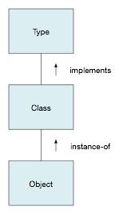
O-O building blocks: types, classes, and objects
A type is an idealized description of an entity
  It specifies the interface (externally visible behavior) for the entity
  It does not deal with the entity’s internal structure (implementation)
  Example: A software product customer
A class represents a particular realization (implementation) of a type
  A class defines mechanisms for behavior of a type
  Example: A customer
A class acts as a template for defining instances of the class (objects)
  Example: Erasmus Darwin, a customer for three software products, all with support contracts
<number> of 96

Slide 6
Types, classes, and objects
Types define interfaces, a class is an implementation of a type.
  A type specifies the externally visible interface for an entity, but does not deal with its implementation
Classes act as abstract templates for producing instances (objects).
  A class represents an implementation of a type and acts as an abstract template for producing instances (objects) via constructors
  Every object is an instance of a class.
  A class has zero or more instances
    Example: Consider static class members in Java
  Class issues are static: attributes (fields), interfaces, and relationships
Objects are dynamic: creation, attribute values, collaborations, and destruction.
Conceptual overlap among types, classes, and objects allows us to sometimes speak of their characteristics interchangeably, what the UML refers to as type-instance correspondence
<number> of 96
Notes:
SE 430
September 8, 2016
Lecture 1
<number> of 96

Slide 7
Class and object characteristics
Every object is an instance of a class—it must have a generating class
A class has zero or more instances
  Example: Consider how static class members in Java allow one to build a class that requires no instances
Class characteristics are static: their attributes, behavior, and relationships are defined and fixed for all instances
  Examples: Attributes (e.g., Java fields), interfaces, and relationships
Objects are dynamic: they are created, have varying attribute values and collaborations, and they can be destroyed
  Example: Erasmus Darwin became a customer; he can add or delete products or change their contract status; he can terminate his relationship with the company
<number> of 96

Slide 8
Types, classes, and objects
Type distinguishes among kinds of objects; its purpose is to control what values can be assigned to variables or used in operations
Most popular object-oriented programming languages do not distinguish between types and classes
Distinctions between types and classes do become important when discussing generalization/specialization and the related topic of inheritance.
<number> of 96
Notes:
SE 430
September 8, 2016
Lecture 1
<number> of 96

Slide 9
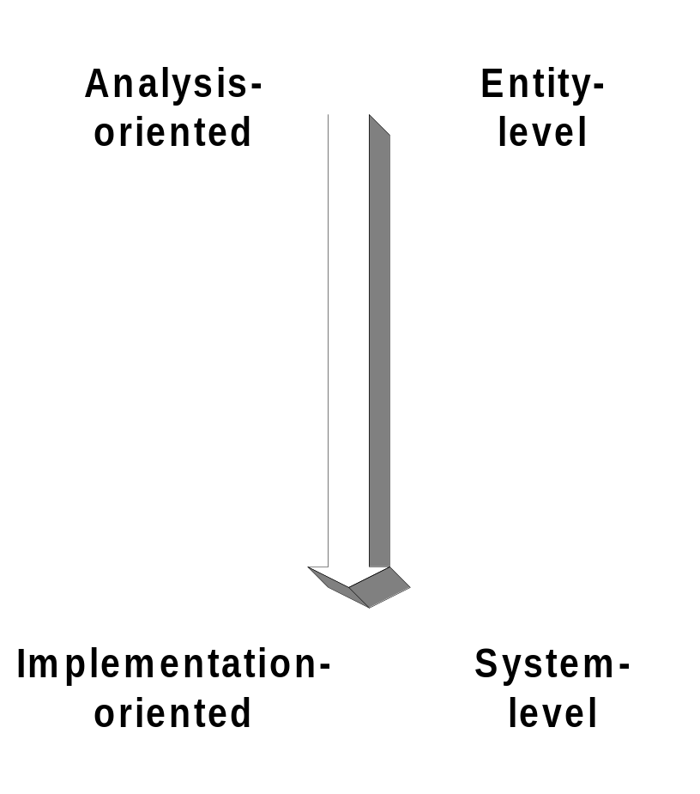
Essential components of O-O paradigm
Abstraction: captures essential behavioral characteristics.
Encapsulation: hides behavioral mechanisms.
Hierarchy: structures abstractions.
Typing: enforces type of object.
Modularity: decomposes a system into manageable pieces.
<number> of 96
Notes:
SE 430
September 8, 2016
Lecture 1
<number> of 96

Slide 10
Core Object Principles
Encapsulation
  Encapsulation revolves around the principle of exposing only as much information about an object as is absolutely necessary.
  Two forms of encapsulation
    "implementation hiding"
    "information hiding.”
Interfaces
  An interface is a contract specifying what properties and behaviors an object will support.
  Interfaces allow the processing of objects based on a type rather than a class.
ICS 2201 : Lecture 1
<number> of 96
Notes:
SE 430
September 8, 2016
Lecture 1
<number> of 96

Slide 11
Abstraction
Captures essential behavioral characteristics of a domain entity.
Communicates what an entity does, not how it does it.
Abstraction detail level depends upon viewer perspective.
Good abstraction follows the ‘just right’ principle: it captures entire behavior of an entity, no more and no less.
  Alternative statement: An effective abstraction captures all the necessary and sufficient characteristics of an entity
<number> of 96
Notes:
SE 430
Entity-level abstraction example: anything with a well-defined purpose.
Coincidental abstraction: Swiss Army knife-like entities.
September 8, 2016
Lecture 1
<number> of 96

Slide 12
Abstraction
Quality of abstraction ranges from:
  Most-desirable entity-level (useful model); a cohesive set of related characteristics and responsibilities to:
    Example: Individual tools in a Swiss Army knife.
    Example: Current java.util.Date
  Least-desirable coincidental (convenient packaging); (possibly unrelated) characteristics and responsibilities
    Example: The whole knife itself.
    Example: JDK 1.0 java.util.Date
  Practice suggestion: Employ a ‘pay-as-you-go’ approach to abstraction characteristics—take an additive approach rather than a subtractive approach to abstraction characteristics
<number> of 96
Notes:
SE 430
Entity-level abstraction example: anything with a well-defined purpose.
Coincidental abstraction: Swiss Army knife-like entities.
September 8, 2016
Lecture 1
<number> of 96

Slide 13
Abstraction
An abstraction is an essential representation of both the intrinsic and behavioral characteristics of an entity
Intrinsic characteristics are those that are static or relate to the state of the entity at a given time
  Example: For a smartphone, size and shape are static, while ‘percent charge’ relates to the state of the battery and its state varies with time
Behavioral characteristics are dynamic
  Behavior may be internally- or externally-induced
  Example: Smartphone generates event reminders internally but dials phone number in response to (external) user button presses
Outstanding question: How do we determine the essential characteristics of an entity for purposes of abstraction?
Appropriate level of abstraction detail depends upon the specific problem to be solved: the problem requirements and constraints
<number> of 96
Notes:
SE 430
Entity-level abstraction example: anything with a well-defined purpose.
Coincidental abstraction: Swiss Army knife-like entities.
September 8, 2016
Lecture 1
<number> of 96

Slide 14
Encapsulation
Compartmentalizes elements of an abstraction, separating:
  Contractual interface (what the abstraction does).
  Implementation (how it does it).
Realized by information/implementation-hiding (security) features of a programming language.
  Example: Java's public, private, and protected modifiers and the compile- and run-time mechanisms that implement the policies
Enforces dictum: “No part of a complex system should depend on the internal details of any other part.”
<number> of 96
Notes:
SE 430
Abstraction/encapsulation pair are the major contributors to class/object
reusability, from a dependence (complexity) standpoint.
Inheritance contributes to class/object reusability from an extensibility
standpoint.
September 8, 2016
Lecture 1
<number> of 96

Slide 15
Encapsulation & abstraction
Encapsulation and abstraction are complementary notions:
  Abstraction defines (or ‘exposes’) the external behavior of an object through the object interface
  Encapsulation hides the internal aspects of that behavior from public view
<number> of 96
Notes:
SE 430
September 8, 2016
Lecture 1
<number> of 96

Slide 16
Abstraction by specification
Provides a concrete approach to achieving the goals of abstraction and encapsulation
Provides behavioral information to allow use of an operation without looking at its implementation:
  Preconditions specify what is assumed upon entering the operation
  Postconditions specify what should be true when the operation completes, provided the preconditions were satisfied
  Invariants specify what must always be true externally for an object
Embodied in the principles of design-by-contract as obligations and benefits
Test-Driven Development (TDD) encourages practical application of abstraction by specification
<number> of 96
Notes:
SE 430
September 8, 2016
Lecture 1
<number> of 96

Slide 17
Hierarchy
Most complex systems can be modeled as hierarchical in nature
Hierarchy is an ordering or structuring of abstractions
Two types of hierarchy:
  Generalization/specialization (‘is kind of ’ or ‘is-a’ relationships)
  Aggregation (‘part of ’ or ‘has part ’ relationships)
Aggregation structure:
  More ‘natural’ hierarchy to develop in the early stages of analysis and design
  Reflects readily-observable characteristics of the domain
Do not concentrate on generalization structure hierarchy in the early stages of analysis and design
<number> of 96
Notes:
SE 430
Note: aggregation comes in two flavors:
regular aggregation - a relationship where one class knows about another
class and uses the class
composition - one class owns the other class and has exclusive access
September 8, 2016
Lecture 1
<number> of 96

Slide 18
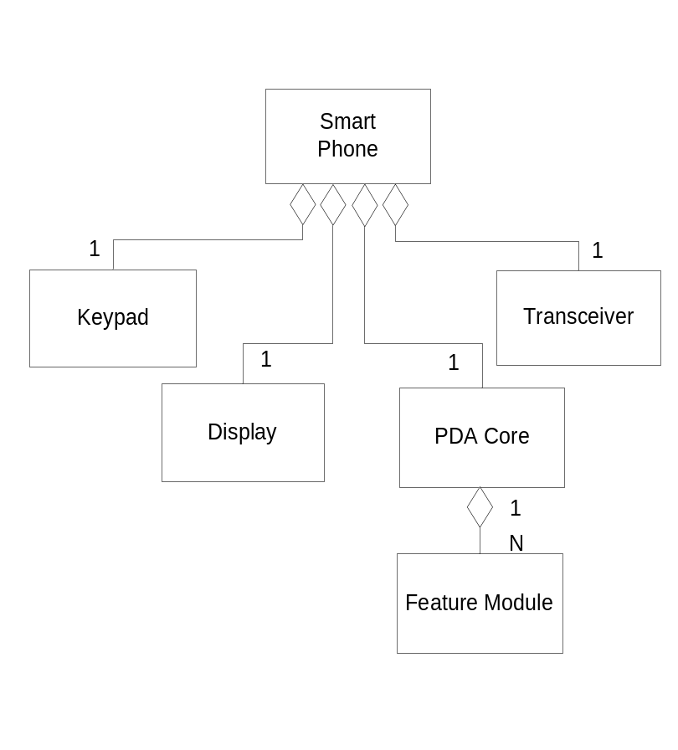
Hierarchy: aggregation
‘Part of ’ hierarchies describe aggregation relationships
Permits physical grouping of logically-related structures, often in repeatable patterns
We’ll discuss the different types of aggregation later in the quarter
We’ll discuss an interplay of aggregation and generalization/specialization in a few slides
<number> of 96
Notes:
SE 430
September 8, 2016
Lecture 1
<number> of 96

Slide 19
Core Object Principles
Inheritance
  Inheritance provides the capabilities for one object to automatically contain attributes and behaviors of another object.
<number> of 96
Notes:
SE 430
September 8, 2016
Lecture 1
<number> of 96

Slide 20
Hierarchy: generalization/specialization
One form of hierarchical ordering leads to creation of a generalization/specialization (‘kind-of’) hierarchy
Defines relationships among related types; the subtypes share the behavioral characteristics of one or more supertypes
A related concept is inheritance: the sharing of code between two classes. A subclass shares the code of its superclass
Most O-O programming languages do not distinguish between subtyping and subclassing
Inheritance only involves sharing of code and does not imply that the subclass is a subtype of the supertype: not all subclasses are subtypes
<number> of 96
Notes:
SE 430
September 8, 2016
Lecture 1
<number> of 96

Slide 21
Subtype and Subclass Examples
Subtypes
  A ‘cellular phone’ is a subtype of ‘telephone’
  A ‘sailboat’ is a subtype of ‘water transport vessel’
  All well-behaved Java classes are subtypes of Object
Subclasses
  A child is a subclass of its two parents
  A speed boat that uses the same engine and some other parts from a sports car is a subclass of that car
  Any Java class which radically alters the behavior of a method inherited from Object
    Example: A subclass which does not adhere to the behavior specifications of the hashcode() and equals(Object o) methods
Bottom line: Strive to have your subclasses be true subtypes
<number> of 96
Notes:
SE 430
September 8, 2016
Lecture 1
<number> of 96

Slide 22
Hierarchy example: generalization
Hierarchical ordering usually leads to generalization/specialization (inheritance) hierarchy.
Defines relationships among classes; classes share structure and/or behavior of one or more superclasses.
Abstraction and encapsulation work to hide internal aspects of objects; inheritance fosters sharing of internal aspects.
<number> of 96
Notes:
SE 430
September 8, 2016
Lecture 1
<number> of 96

Slide 23
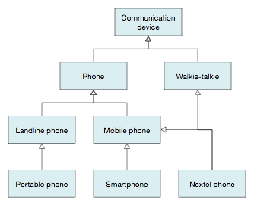
Generalization/specialization hierarchy
Generalization/specialization represents ‘is-kind-of’ relationships among related types
Example: Smartphone is-kind-of mobile phone is-kind-of phone is-kind-of communication device
More-specialized subtypes share specific behavioral and structural properties of their more-general supertypes
Practice suggestion: Postpone effort on generalization/specialization structure hierarchy until later stages of analysis
is kind of
Basic UML class diagram notation illustrating generalization/specialization relationships among
different types of communication devices
<number> of 96

Slide 24
Liskov Substitution Principle
In order for a subclass to be considered a subtype, it must meet the requirements of the Liskov Substitution Principle
Requires that subtype specification supports reasoning based on the supertype specification
Three properties must be supported:
  Signature rule. Subtype must have all the methods of supertype and subtype parameter signatures must be compatible with corresponding supertype methods
  Methods (behavior) rule. Invocations of subtype methods must ‘behave like’ corresponding supertype methods even if they override (reimplement) the method
  Properties rule. Subtype must preserve all properties (such as pre- and post-conditions and invariants) that can be proved about supertype
<number> of 96
Notes:
SE 430
September 8, 2016
Lecture 1
<number> of 96

Slide 25
Liskov Substitution Principle
Implications:
  A subtype instance may be substituted where a supertype instance is required
  Reverse is not true: a supertype cannot be substituted for a subtype
<number> of 96
Notes:
SE 430
September 8, 2016
Lecture 1
<number> of 96

Slide 26
Generalization/specialization example
java.lang.Object // root of class hierarchy
java.util.AbstractCollection // skeletal implementation of Collection interface
java.util.AbstractSet // skeletal implementation of Set interface
java.util.HashSet // Set backed by Hashtable
java.util.LinkedHashSet // predictable iteration order
This represents a fairly deep specialization hierarchy in Java, which makes use of inheritance in the deeper subclasses in order to share code
This hierarchy obeys the Liskov Substitution Principle: you can substitute the subclasses in any reasoning you would do about the superclasses
<number> of 96
Notes:
SE 430
September 8, 2016
Lecture 1
<number> of 96

Slide 27
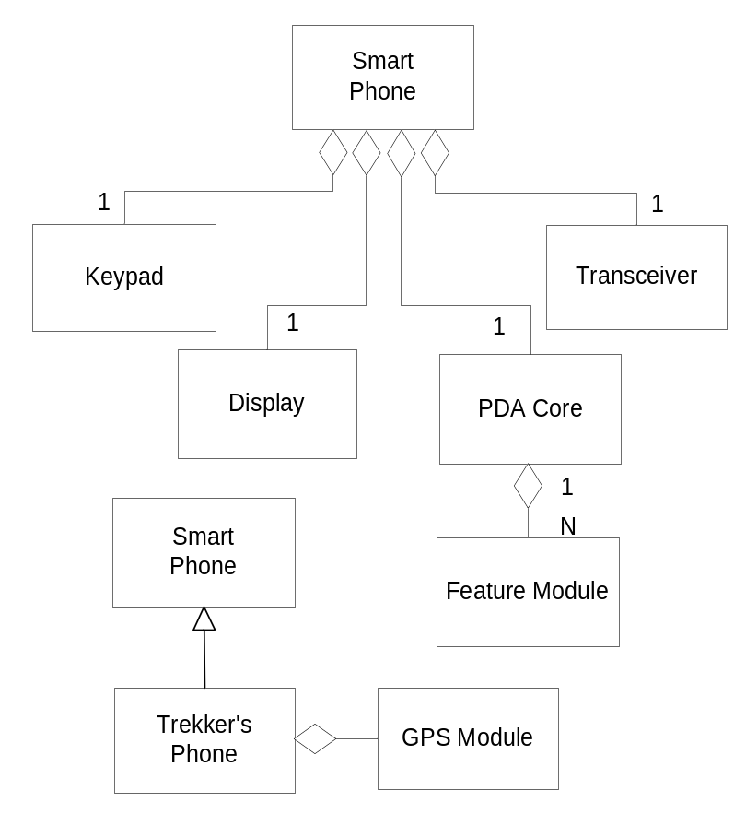
Aggregation revisited
Recall: Permits physical grouping of logically-related structures, often in repeatable patterns
Inheritance allows these common groups of logically-related structures and patterns to be reused among different abstractions
Examples: Hypothetical “Trekker’s Phone” or Motorola iDEN (Nextel-type) combination phone/walkie-talkie devices
Inherits all the structures of Smart Phone and adds GPS capability
<number> of 96
Notes:
SE 430
September 8, 2016
Lecture 1
<number> of 96

Slide 28
Typing
Typing can help enforce design decisions.
Two dimensions to typing:
  Strong (versus weak) typing provides type consistency and avoids incompatibility among objects at run time.
  Static/dynamic binding refers to the time when a specific implementation of a method is bound to a method invocation.
Strong and static typing are done at compile time, while weak and dynamic typing are done at run time.
Generalization + dynamic binding ⇒ polymorphism
<number> of 96
Notes:
SE 430
September 8, 2016
Lecture 1
<number> of 96

Slide 29
Core Object Principles
Polymorphism
  Polymorphism is the concept of an object changing its form to conform to a generic object abstraction.
  Parametric polymorphism uses the concept of a common interface or lowest common denominator in terms of inheritance to implement a single abstraction across a number of types.
  Foo bar = new Foo(42);
  out.println(42);
  out.println("42");
  out.println(42.0);
  out.println(bar);
<number> of 96
Notes:
SE 430
September 8, 2016
Lecture 1
<number> of 96

Slide 30
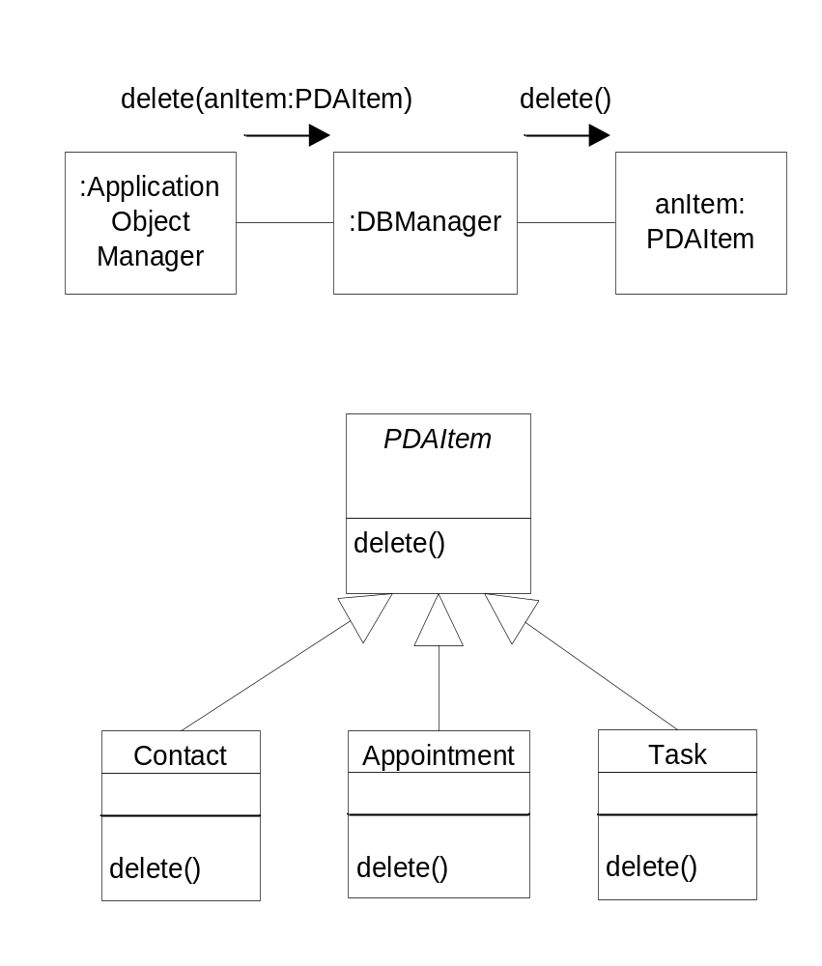
Parametric Polymorphism
Allows a single parameter name in a method to denote objects of several different classes
All these classes must be related by a common superclass
Any object denoted by this single parameter name is able to respond to a common set of operations in different, specific ways
Note application of Liskov Substitution Principle here!
May be an instance of Contact, Appointment, or Task
Dynamic binding mechanism chooses the correct delete() implementation at invocation
<number> of 96
Notes:
SE 430
September 8, 2016
Lecture 1
<number> of 96

Slide 31
Core Object Principles
Coherence
  Coherence is the concept of modeling objects in such a way that they reflect, as accurately as possible, the actual properties and behaviors of real-world entities.
<number> of 96
Notes:
SE 430
September 8, 2016
Lecture 1
<number> of 96

Slide 32
Modularity
Property of a system that may be decomposed into a set of cohesive and loosely-coupled components.
  A cohesive component is one which has a set of well-defined and focused responsibilities
  Loosely-coupled components depend only on public knowledge (i.e., the public interfaces) of a limited number of other components
  Loose coupling means aggregation or using relationships.
Module granularity: the ‘natural’ size of a system component suitable for separation.
  Example: An assembled phone is the appropriate granularity for the information system managing the packaging production line
  Example: Java has a range of module granularities: class, package, and bean
Modularity expresses a critical aspect of the system architecture.
Module granularity and organization—but not modularity, in general—are design, not analysis, concerns: do not try to resolve too early.
<number> of 96
Notes:
SE 430
Modularity can also be used to provide product coherence: i.e. making
individual products stand by themselves and work together as part of
a suite.
September 8, 2016
Lecture 1
<number> of 96

Slide 33
Object Oriented Concepts
Object Identity
every object has its own identity (regardless of its class or attribute values).
Usually implemented with a pointer reference (object-handle)
The object-handle is unique for every object
Composition
use components that interact to accomplish a task
Build complex "whole" systems by assembling simpler "parts" by association or aggregation
<number> of 96
Notes:
SE 430
September 8, 2016
Lecture 1
<number> of 96

Slide 34
Object Oriented Concepts
Message Passing
Objects communicate to other objects via message passing.
Very few objects can accomplish the necessary tasks by themselves. They have to work with other objects.
Messages contain the object-handle, name of the operation that is to be performed and any additional arguments that should be used in the operation.
The message sender does not have to know the exact class of the receiver
<number> of 96
Notes:
SE 430
September 8, 2016
Lecture 1
<number> of 96

Slide 35
Class and Object
Difference between Class and Object
Class –
  A description of a set of objects that have something in common.
  Class is also a programming concept used to define objects that have the same attributes, operations, relationships and semantics.
Object –
  Is an instance of a Class.
  Objects are created from a Class at run-time. Since Classes have state, an object retains information about its attributes for some indefinite time. This is different than functions or subprograms.
September 8, 2016
SE 430: Lecture 1
<number> of 96
Notes:
SE 430
September 8, 2016
Lecture 1
<number> of 96

Slide 36
Concepts
Separation of concerns
  “An object has one responsibility and does it well.”
Chain of responsibility
  If an object should/can not do something, it can delegate the responsibility/request/service to another object (Delegate pattern).
Objects should be viewed as providing services
<number> of 96
Notes:
SE 430
September 8, 2016
Lecture 1
<number> of 96

Slide 37
Vocabulary
Class — a object type or one of its components as indissoluble combination of information and behavior
Attribute — an information field as one of the features of a class
Service — an elementary routine defining a specific type of behavior of a class
Relationship — a link between classes expressing a specific relationship or dependency between them
Actor — a party (organization) which performs actions in the domain
<number> of 96
Notes:
SE 430
September 8, 2016
Lecture 1
<number> of 96

Slide 38
Object Oriented Approach to Analysis
The most appropriate programming structures should be based on relevant objects of the application domain.
Organize software as a collection of objects containing
  Data structure
  Behavior
Build an object model of an application domain
Add implementation details to the model during design
<number> of 96
Notes:
SE 430
September 8, 2016
Lecture 1
<number> of 96

Slide 39
Object Oriented Approach
OO analysis should emphasize
Front-end conceptual issues (analysis)
Data structure before function
Be iterative not sequential
Language of the application domain
OO analysis should not emphasize
Back-end implementation (code)
<number> of 96
Notes:
SE 430
September 8, 2016
Lecture 1
<number> of 96

Slide 40
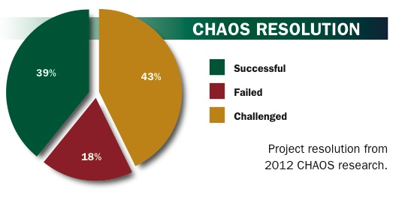
Chaos Report 2012
Project Success: Type 1. The project is completed on-time and on-budget, with all features and functions as initially specified. (2012: 39%)
Project Challenged: Type 2. The project is completed and operational but over-budget, over the time estimate, and offers fewer features and functions than originally specified. (2012: 43%)
Project Impaired: Type 3.
The project is canceled at some point
during the development cycle.
(2012: 18%) (Are ALL impaired
projects failures???)
<number> of 96
Notes:
September 8, 2016
Lecture 1
SE 430
<number> of 96

Slide 41
Software: why is it hard?
Software production often runs into problems, because it is mostly concerned with completing a design that works as soon as possible
Each development activity is focused on developing a specific feature
Products (and even different sections within a product) are designed independently from each other
Software systems can become extremely complex during the development process
The best methods for controlling this complexity are abstraction and encapsulation: if we use some techniques for building software that is less complex, we will get benefits in
  software that is more flexible: easier to maintain and modify later
  some opportunities to reuse designs and code
September 8, 2016
SE 430: Lecture 1
<number> of 96
Notes:
SE 430
September 8, 2016
Lecture 1
One of the principal themes of this course will be: How can we manage the
complexity of our software through encapsulation?
Object oriented analysis and design is one approach
It is necessary to do some extra up-front planning work (in the areas of
architecture planning, object oriented modeling, and design documentation)
How can we justify this extra work? The extra effort that is required to do detailed
modeling of the interactions of objects is viewed by many as a bunch of wasted
activity. But this modeling process can help produce better documentation for each
piece of a larger design (so you can figure out what pieces are useful in solving
other problems - identifying candidates for “reusable design elements”), the
modeling process helps to steer development in the direction of “strong
encapsulation” (so it is easier to move pieces of code from one place to another),
and modeling encourages the reuse of existing artifacts (so you can exploit existing
classes, frameworks, and patterns).
<number> of 96

Slide 42
Software Development Process
Ad hoc
  Code and Fix
  Rapid Prototyping
Prescriptive
  Linear (Classic and Waterfall)
  Evolutionary (Iterative/incremental or spiral)
  Unified Process
Adaptive
  Lean and agile methods
September 8, 2016
SE 430: Lecture 1
<number> of 96
Notes:
SE 430
September 8, 2016
Lecture 1
<number> of 96

Slide 43
The traditional software lifecycle
Feasibility study
Requirements analysis and specifications
Design and specification
Implementation (coding and module test)
Integrate/test (system testing)
Install/operate (delivery)
Maintain - 70% of cost
Frame of reference for us
September 8, 2016
SE 430: Lecture 1
<number> of 96
Notes:
SE 430
September 8, 2016
Lecture 1
<number> of 96

Slide 44
Waterfall Life-cycle
The most traditional software development lifecycle model is a linear process (sometimes called the “waterfall model”):
Each activity has to be completed before the next activity is started
  For example, requirements writing must be complete before analysis can begin
  No coding work is started before the design documents are finished
It is a very efficient process for solving a well-understood problem
But there is no support for “iteration”: it is difficult to add in some of the things that are learned during the development process
September 8, 2016
SE 430: Lecture 1
<number> of 96
Notes:
SE 430
September 8, 2016
Lecture 1
This slide shows an extreme version of the “waterfall model” – there are many
“modified waterfall” processes that are closer to the way that systems are built
in the real world.
Many organizations define the “phases” of the waterfall document by giving a
definition of the “phase-ending document” that each phase produces. There might
be a requirements document, a specification document, a design document, ... (or, in
other projects that have different boxes in their mode, an architecture document, an
analysis document, …), leading up to the actual code (the output of the coding phase).
<number> of 96

Slide 45
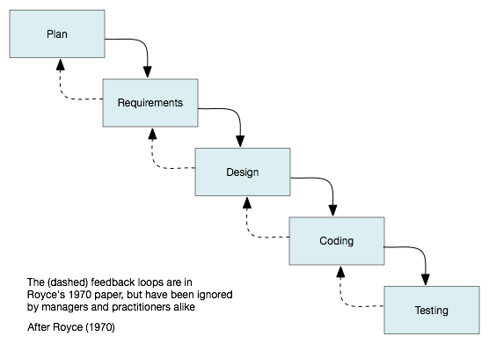
Waterfall Life-cycle
September 8, 2016
SE 430: Lecture 1
<number> of 96
Notes:
SE 430
September 8, 2016
Lecture 1
This slide shows an extreme version of the “waterfall model” – there are many
“modified waterfall” processes that are closer to the way that systems are built
in the real world.
Many organizations define the “phases” of the waterfall document by giving a
definition of the “phase-ending document” that each phase produces. There might
be a requirements document, a specification document, a design document, ... (or, in
other projects that have different boxes in their mode, an architecture document, an
analysis document, …), leading up to the actual code (the output of the coding phase).
<number> of 96

Slide 46
Waterfall Life-cycle
The term waterfall was coined by Winston Royce in a 1970 paper titled Managing the Development of Large Software Systems, in the Proceedings of IEEE WESCON (Western Electronic Show and Convention)
The paper used the (pure) sequential waterfall approach as an example of an ill-conceived, risk-prone practice for developing large systems
Royce advocated adding a series of iterative feedback loops among the development stages, incrementally gaining learning value from working software
Instead of adopting the approach Royce advocated, managers and practitioners adopted its anti-form, without feedback loops
September 8, 2016
SE 430: Lecture 1
<number> of 96
Notes:
SE 430
September 8, 2016
Lecture 1
<number> of 96

Slide 47
Waterfall Life-cycle
Advantages of a Waterfall Life-cycle
Easy to manage; Project Management (PM) tools support cycle: GANNT and PERT charts
Disadvantages of a Waterfall Life-cycle
Complexity overload at the beginning of the cycle
Specifications frozen early, while business environment changes
Delayed feedback, if any
  If there are design incompatibilities do not find out until late in the cycle
  Similarly for incorrect or incomplete requirements
  Fix fatal bugs now, but
  Make changes in next release (if any)
September 8, 2016
SE 430: Lecture 1
<number> of 96
Notes:
SE 430
September 8, 2016
Lecture 1
<number> of 96

Slide 48
Iterative Development
Iterative Development
Successive enlargement and refinement of a system through multiple development cycles of analysis, design, implementation and testing.
Spiral Model
Developed by Barry Boehm at TRW in 1988
Incorporates risk management as an integral part of the life cycle
Prior to every major phase, risks are identified and analyzed, and steps are taken to avert them
If progress is not adequate, the project may be abandoned
September 8, 2016
SE 430: Lecture 1
<number> of 96
Notes:
SE 430
September 8, 2016
Lecture 1
<number> of 96

Slide 49
Evolutionary Model (Spiral)
Software is developed in a series of incremental releases ranging from early prototypes to complete engineered versions of the system.
Characterized by
  Risk driven approach
  Milestones
Weaknesses
  Convincing customers that evolutionary approach is controllable.
  Demands expertise in risk assessment.
Strengths
  Matches the natural progression of a project.
  Reduces risk
September 8, 2016
SE 430: Lecture 1
<number> of 96
Notes:
September 8, 2016
Lecture 1
<number> of 96

Slide 50
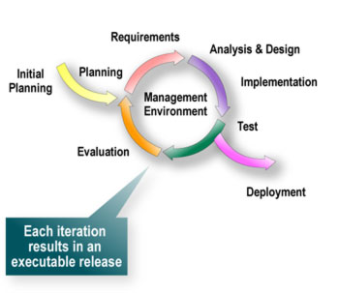
Iterative Development
September 8, 2016
SE 430: Lecture 1
<number> of 96
Notes:
SE 430
September 8, 2016
Lecture 1
<number> of 96

Slide 51
An alternative development process
An “iterative and incremental” development approach is best when using object oriented analysis and design
  incremental development:
    the development team produces a series of functioning software systems
    each partial system contains an larger and larger subset of the total functionality
  iterative development:
    on each cycle, the quality and accuracy of the models is checked
    the customer might decide that some parts of the model are incorrect and need revision to change the externally visible behavior
    the developers may decide that some parts of the model have poor performance and need revision to improve the internal operation
first analysis
model
first design
model
first small
implementation
second analysis
model
second design
model
second
implementation
. . .
September 8, 2016
SE 430: Lecture 1
<number> of 96
Notes:
SE 430
This is the software development approach advocated by many OO writers, such
as Grady Booch from Rational Inc.
One of the design goals of the UML notation was to create a set of notations that
could work together with this kind of development process. In the UML overview
document, the authors point out: “Although the UML does not mandate a process,
its developers have recognized the value of a use-case driven, architecture-centric,
iterative, and incremental process, so were careful to enable (but not require) this
with the UML.”
The iterative and incremental approach does have some unique challenges…
September 8, 2016
Lecture 1
<number> of 96

Slide 52
Iterative Development
Iterative development Concept uses multiple development cycles
Time-boxing a Development Cycle
  A cycle is two weeks to two months
  Choose requirements carefully
  Each cycle tackles a relatively small set of requirements.
    Implementation of part of a use case or (1 or more use cases)
  Rank order use cases.
  Choose requirements carefully.
The system grows incrementally as each cycle is completed.
Some cycles are devoted to non-evident requirements
September 8, 2016
SE 430: Lecture 1
<number> of 96
Notes:
SE 430
September 8, 2016
Lecture 1
<number> of 96

Slide 53
Problems
The iterative and incremental approach is more difficult to manage:
  It isn’t always possible to say “we are X% complete”
  Team members are tempted to abandon all attempts at high-level planning: there is a tendency to revert to “hacking” instead of working to understand system requirements, developing a complete analysis model, or creating design-level descriptions of the key parts of the solution
  The documentation of the system always seems as if it is in a state of flux
But it has some advantages over traditional “waterfall” approaches:
  It is easier to manage risk - you can evaluate some of the critical technology choices early in the project’s timeline
  In the waterfall process, the system integration step is very difficult
    And you find out about some incorrect assumptions late in the development cycle
September 8, 2016
SE 430: Lecture 1
<number> of 96
Notes:
SE 430
In the traditional waterfall process, one critical problem is putting all of the pieces of
software together at the end: the integration step. The waterfall process is said to
have a “big-bang” of integration at the end of the coding phase.
The iterative and incremental process replaces the “big-bang” integration at the end
of the development cycle with “a lot of little bangs”. This can help reduce risk,
because potential integration problems can be ironed out without having to throw
out or rework a large amount of coding work.
The iterative and incremental approach can create problems in measuring the rate of
progress. It is important to do some initial planning to put a bound on the number of
increments and to document the goals of each cycle.
September 8, 2016
Lecture 1
<number> of 96

Slide 54
Iterative Development
Advantages of Iterative Development
Complexity reduced – avoids analysis paralysis and design paralysis.
Early overall system integration and testing
Early feedback from implementation
Requirements can be adjusted to match changing business needs
Main disadvantage of Iterative Development
Raised expectations by the client and management.
September 8, 2016
SE 430: Lecture 1
<number> of 96
Notes:
SE 430
September 8, 2016
Lecture 1
<number> of 96

Slide 55
The Software Development Life Cycle
Waterfall method
  Royce, W.W.: Managing the development of large software systems. In Proc. WESTCON, San Francisco CA. 1970.
Spiral method
  Boehm B. W.: A spiral model of software development and enhancement. IEEE Computer, 21 (5), 61-72. 1988.
Agile methodologies
  Similar to spiral
September 8, 2016
SE 430: Lecture 1
<number> of 96
Notes:
SE 430
September 8, 2016
Lecture 1
<number> of 96

Slide 56
Object-Oriented Analysis & Design and the Unified Process
September 8, 2016
SE 430: Lecture 1
<number> of 96
Notes:
SE 430
September 8, 2016
Lecture 1
<number> of 96

Slide 57
Object-oriented analysis & design
Analysis
  Discover the key abstractions that form the vocabulary of the problem domain.
  Remove programming language concepts and emphasize the language of the domain.
  Invent additional domain abstractions and mechanisms.
  Abstractions, their behavior, and interactions that define the conceptual model of the problem (not software) domain
Design
  Structure the system within an architectural framework
  Map analysis abstractions into a software design class hierarchy.
  Assemble objects (class instances) and their behaviors into collaborations.
  Discover and invent software abstractions not in the problem domain but needed for implementation
  Organize classes in hierarchies
September 8, 2016
SE 430: Lecture 1
<number> of 96
Notes:
SE 430
September 8, 2016
Lecture 1
<number> of 96

Slide 58
Object-oriented analysis
Defines the problem domain according to the requirements
Sets the basic “vocabulary” of the problem domain for the design and coding activities
Surveys the possible solutions and discusses tradeoffs
Provides the environment for productive team analysis
Models the problem from the object perspective
One advantage of object oriented analysis: the analysts don't have to be “language experts”
  The experts in the problem domain and the implementation-level experts can communicate using a common notation
September 8, 2016
SE 430: Lecture 1
<number> of 96
Notes:
SE 430
Analysis methods (even simple, low-tech methods like CRC cards) are especially
useful in defining the basic vocabulary that will be used by a large development team.
Traditional Lucent systems engineering procedure is to define all of the features of the system, but in object oriented analysis, the analysis proceeds one step further. The system behavior is decomposed into pieces of behavior that are assigned to
“analysis-level objects”.
The analysis-level objects are “elaborated” during design and coding. The design
and code may contain classes that weren’t in the original analysis, but in a good
design, there is “traceability” from analysis through design to code and test.
September 8, 2016
Lecture 1
<number> of 96

Slide 59
Object-oriented design
Takes the products produced by analysis, then details and designs the solution in terms of some target environment
Concerned with real-world concerns like
  Reliability
  Performance
  Capacity
Deals with “assignment of functionality to different processes or tasks”, so there is significant knowledge of the operating system at design time
Deals with database issues and “distributed object environments”
Object oriented analysis and object oriented design use the same kinds of modeling notations - the main difference is “problem” vs. “solution” modeling
September 8, 2016
SE 430: Lecture 1
<number> of 96
Notes:
SE 430
Object oriented design deals with a large number of technical issues. In most cases,
the analysis model is “technology-neutral”, but the design has to deal with
technology tradeoffs.
In object oriented systems, some of the technology decisions can be very hard.
For example, should you choose a relational database management system or
should you use an object database instead? If objects need to communicate
between processes and/or processors, you might choose an distributed object
architecture based on CORBA or Microsoft’s DCOM/ActiveX.
September 8, 2016
Lecture 1
<number> of 96

Slide 60
Object-oriented programming
Translates OO design into code
OO programming can actually be done in any language: even C, COBOL, or assembler
There are languages that provide better support for OO programming
  Examples: Smalltalk, Java, C++, C#
  These languages support the notions of class, object, messaging, inheritance, encapsulation, polymorphism
In object oriented programming, reuse of existing libraries is very important
OO programs often create new objects as needed (and destroy them when they are no longer active), so OO programs may use a lot of “dynamic memory”
September 8, 2016
SE 430: Lecture 1
<number> of 96
Notes:
SE 430
Object oriented programming does not require any special programming language,
but it is a good idea to use a language with some support for some of the low-level
mechanisms that are mentioned above. OO programming in a non-OO language can
add a lot of unnecessary work.
The C++ programming language is “a language that supports object oriented
programming”, but it does’’t require object oriented programming. Many people think
their software is object oriented just because they wrote it in C++. In order to be truly
object oriented C++, most of the code for the system should be in classes.
September 8, 2016
Lecture 1
<number> of 96

Slide 61
Object Oriented Modeling
An Object-Oriented System
Depends on "local" knowledge of objects to accomplish their tasks. There are very few things an object can do on its own, in order to accomplish any significant task, objects must communicate with other objects.
Emphasis on Abstraction
Model relevant attributes and behavior of a given entity for a particular purpose.
Focus on what an object "is" and "does.”
Class defines both behavior and state.
September 8, 2016
SE 430: Lecture 1
<number> of 96
Notes:
SE 430
September 8, 2016
Lecture 1
<number> of 96

Slide 62
Examples of object-oriented models
Requirements and analysis:
  Use case diagram
  Interface model
  Business/Domain Object model
  Application Object model
  Object Interaction model
  Dynamic model
Design:
  Design Object model
  Design Object Interaction model
  Design Dynamic model
Implementation
  Source code
Testing
  Test cases
September 8, 2016
SE 430: Lecture 1
<number> of 96
Notes:
SE 430
The items listed above are models that are part of the Unified Modeling language (UML).
UML is an “industry-standard” OO modeling notation developed by Rational Software Corp. and
supported by many different CASE tools. We will not be able to cover all the models in this class.
But we will focus on the key models, we will cover:
use cases for identifying and documenting scenarios (in unit 2)
the CRC card method (in unit 3), which can be used to identify the principal objects for
“generic” object modeling (i.e. either at the problem domain level, analysis level, or
design level)
the standard UML Class diagram notation (in unit 4)
state diagrams and collaboration diagrams (in unit 5), which are techniques for identifying
and documenting the dynamic behavior of the system
September 8, 2016
Lecture 1
<number> of 96

